Slide 1
UNIT 1: INTRODUCTION TO GAME DESIGN

Slide 2
UNIT DESCRIPTION
Activities in this unit of instruction are designed to provide a high level overview of game design and the game creation process. Learners will be introduced to various game genres during this unit. They will also become familiar with elements of game play and project management concepts, as related to interactive application and video game creation.

Slide 3
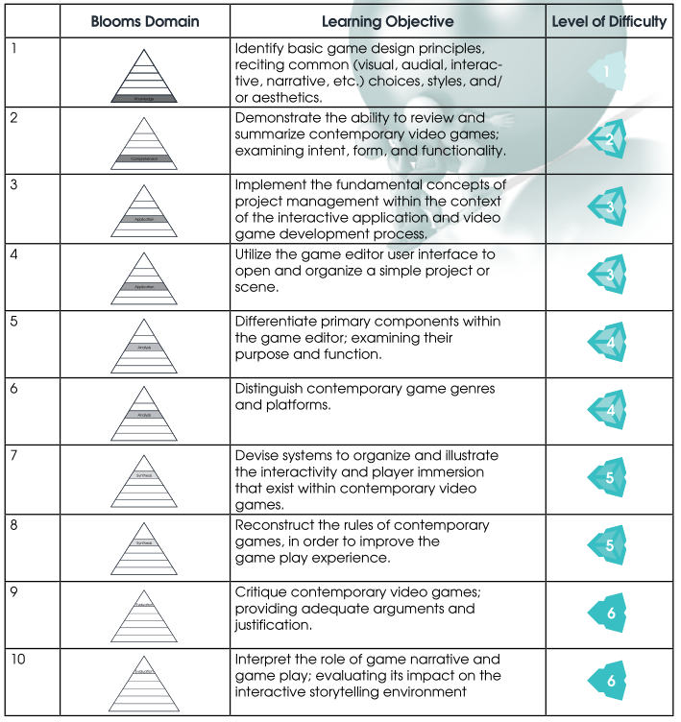
LEARNING OBJECTIVES
By the end of this unit, learners should be able to perform the following tasks:

Slide 4
COURSE OUTLINE

Slide 5
1. Game/Application Design Overview
a. What is a game/application and how is it created?
b. What makes a game enjoyable?
c. Knowing the players
d. Game genres
e. Game Platforms
Notes:
Buat percakapan tentang develop game jaman dulu
Apa yang membuat game menyenangkan? Menjadi karakter utama? Lebih jago dari temen? Suka ceritanya? Suka menyelesaikan suatu problem? Mind set kreatif? Strategic thinking? Team building? Atribut/stats increment? Hobi?
Cek next slide
Shows picture of games?
Picture about consoles, pc, handheld

Slide 6
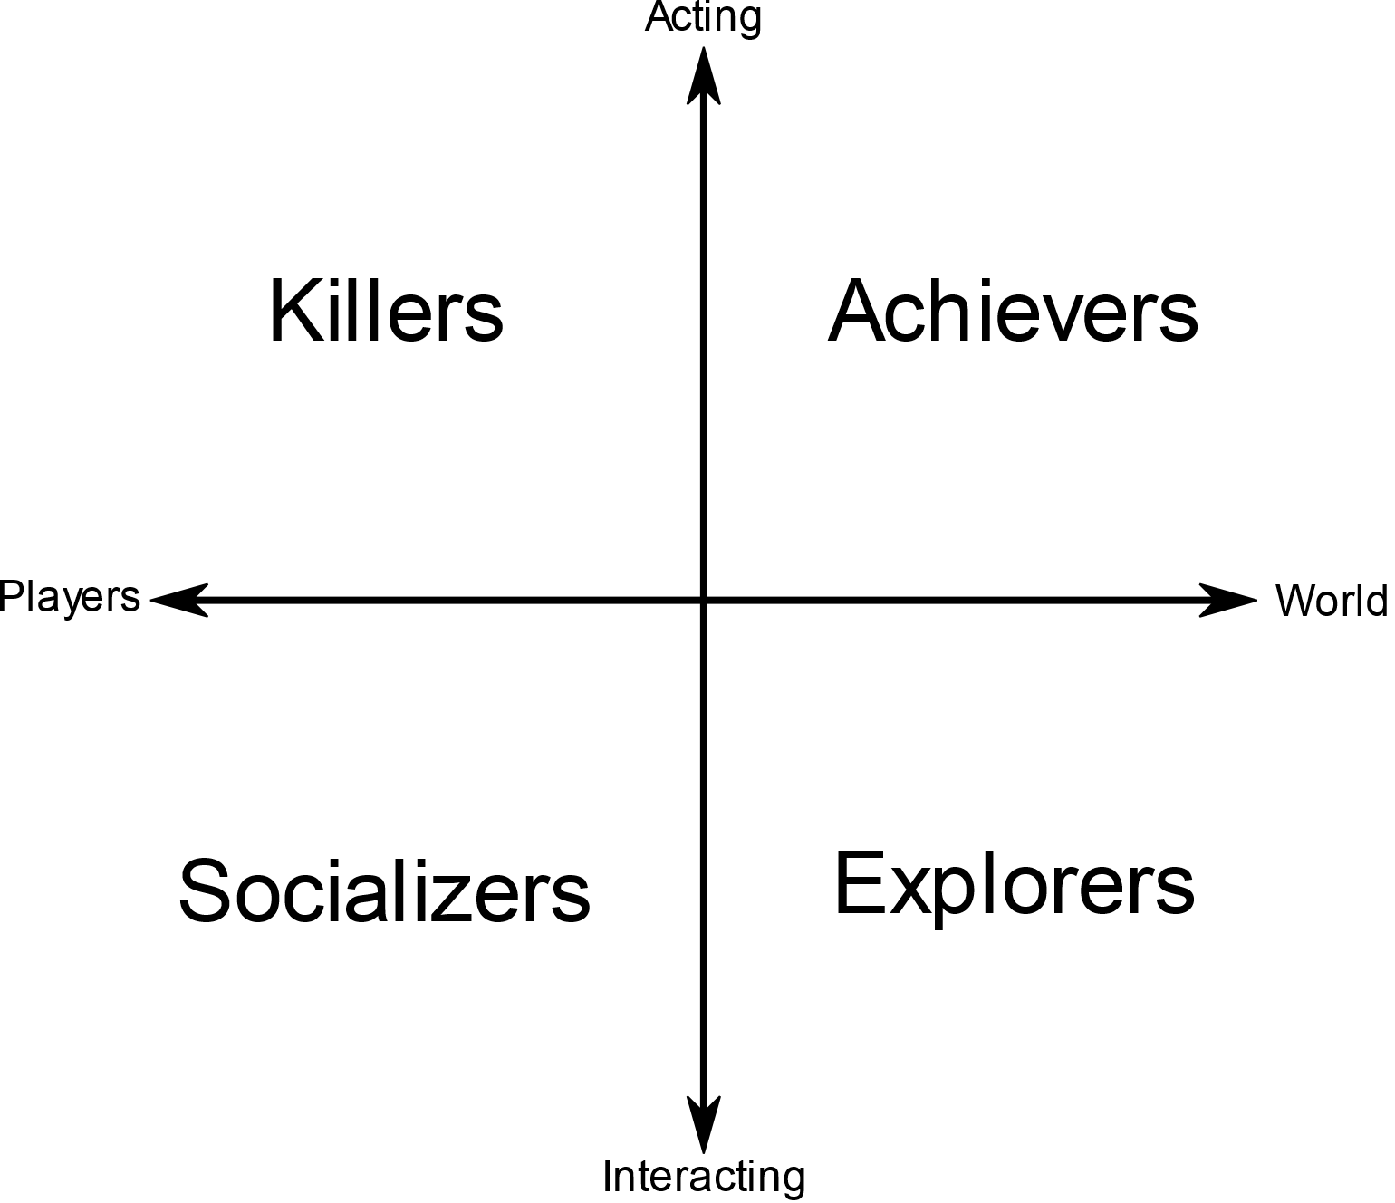
Character Theory Chart
http://www.4you2learn.com/bartle
Notes:
Archiever
Also known as "Diamonds", these are players who prefer to gain "points", levels, equipment and other concrete measurements of succeeding in a game. They will go to great lengths to achieve rewards that confer them little or no gameplay benefit simply for the prestige of having it.
Explorers
Explorers, dubbed "Spades" for their tendency to dig around, are players who prefer discovering areas, creating maps and learning about hidden places. They often feel restricted when a game expects them to move on within a certain time, as that does not allow them to look around at their own pace. They find great joy in discovering an unknown glitch or a hidden easter egg.
Socializers
There are a multitude of gamers who choose to play games for the social aspect, rather than the actual game itself. These players are known as Socializers or "Hearts". They gain the most enjoyment from a game by interacting with other players, and on some occasions, computer-controlled characters with personality. The game is merely a tool they use to meet others in-game or outside of it.
Killers
"Clubs" is a very accurate moniker for what the Killer likes to do. They thrive on competition with other players, and prefer fighting them to scripted computer-controlled opponents.

Slide 7
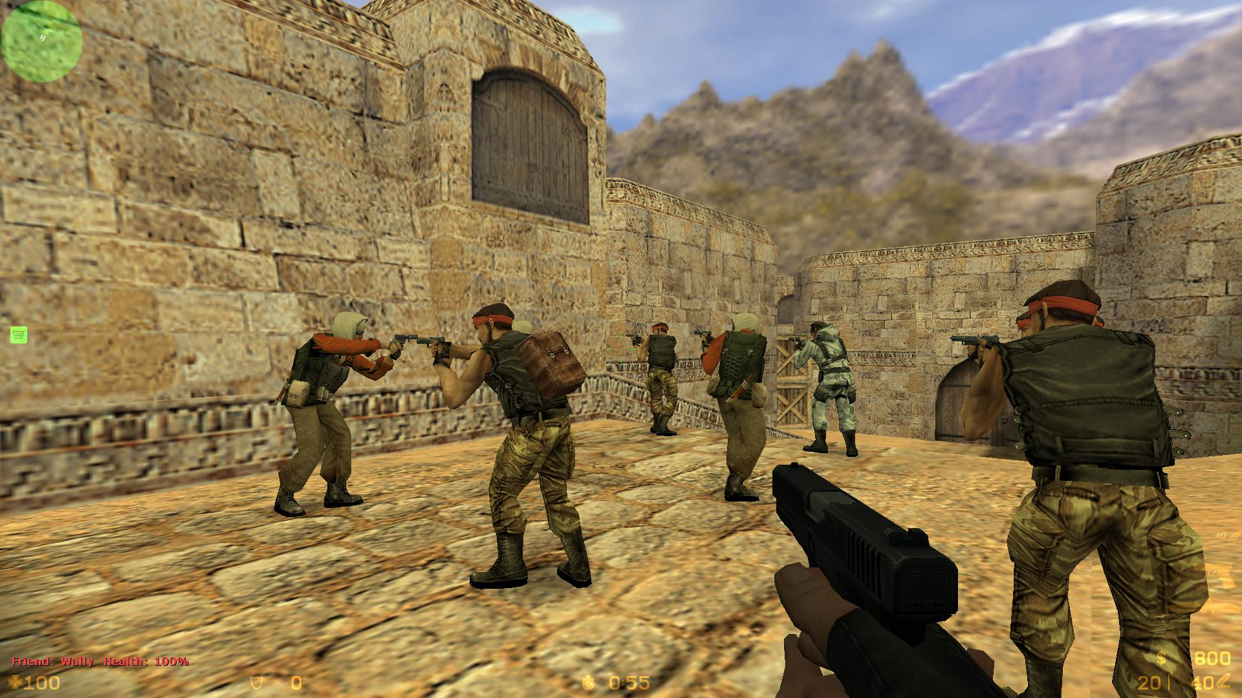

Slide 8
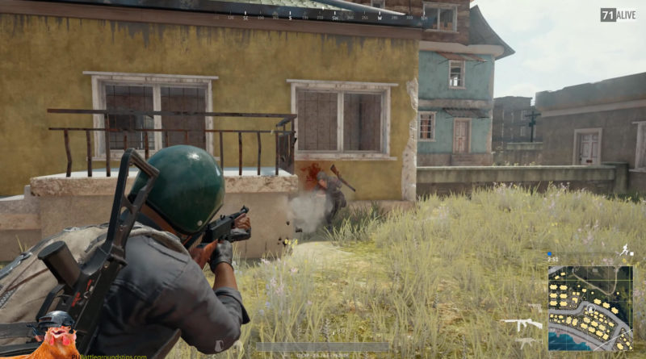

Slide 9
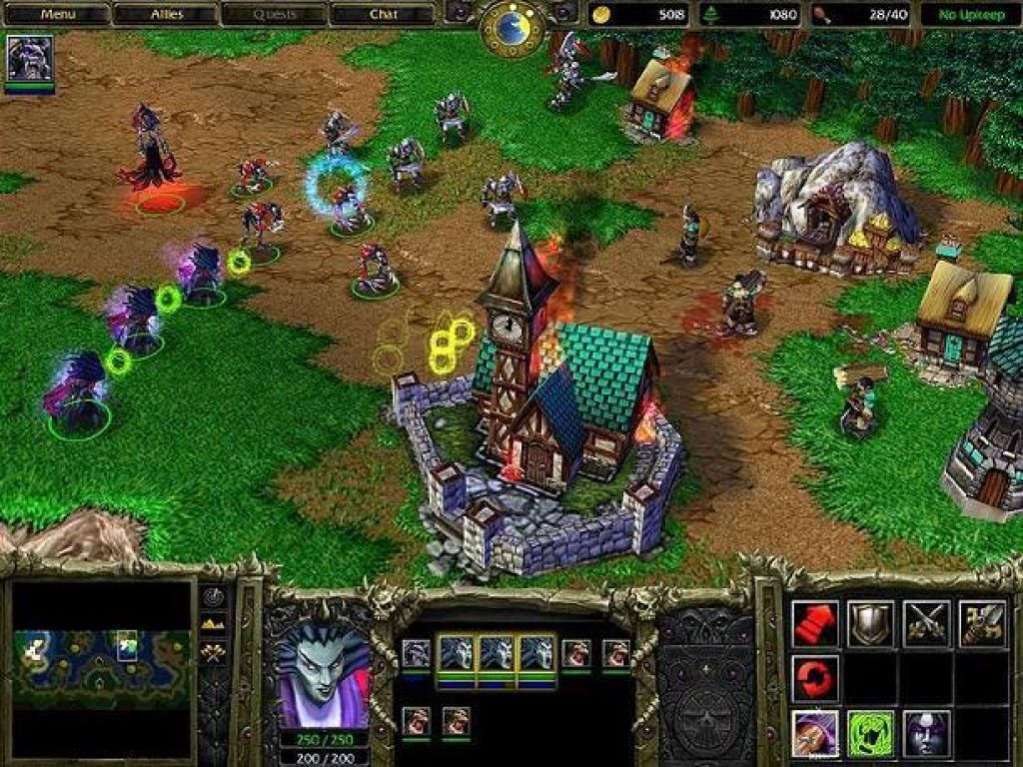

Slide 10
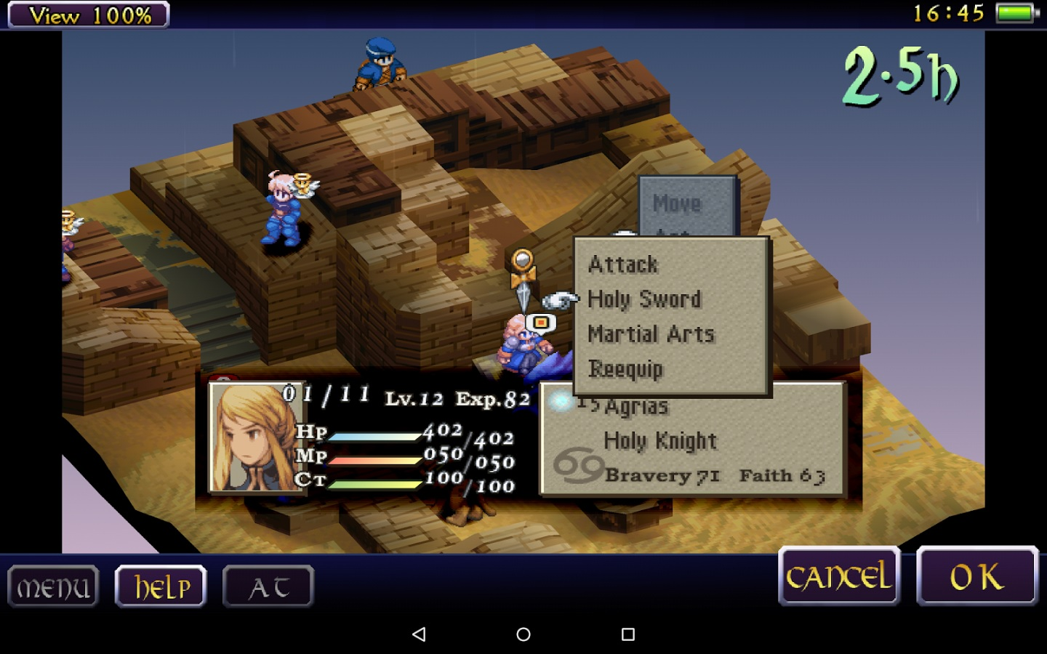

Slide 11
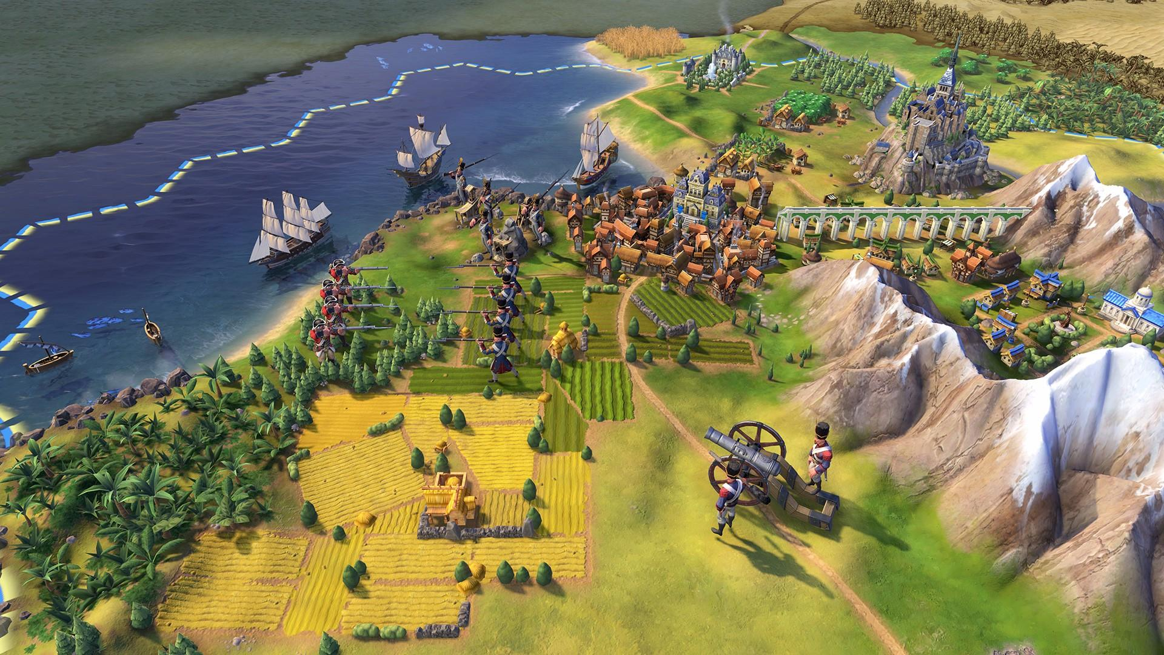

Slide 12
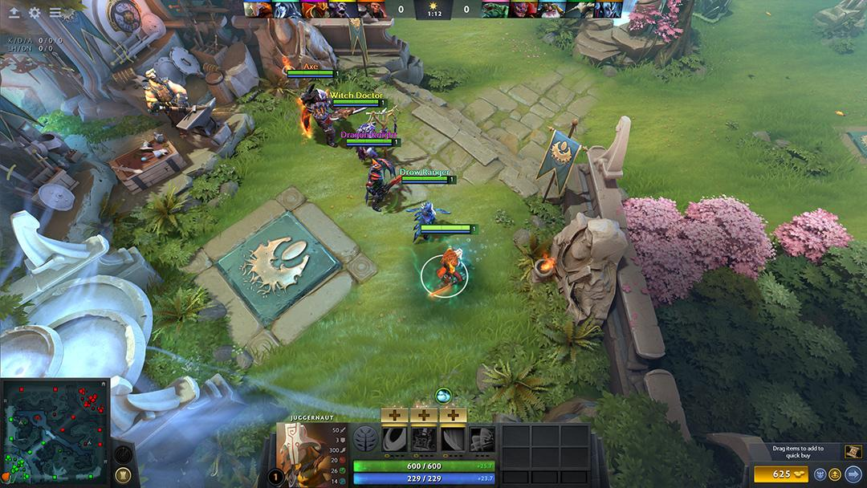

Slide 13
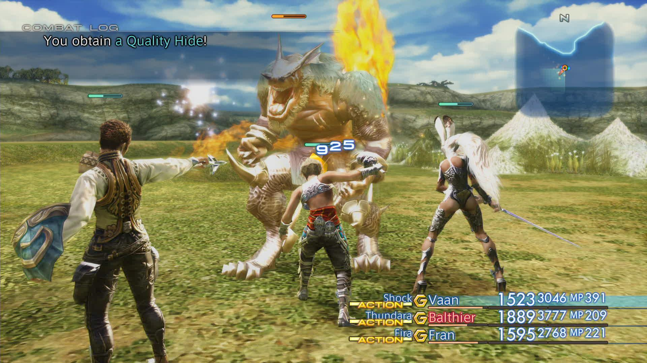

Slide 14
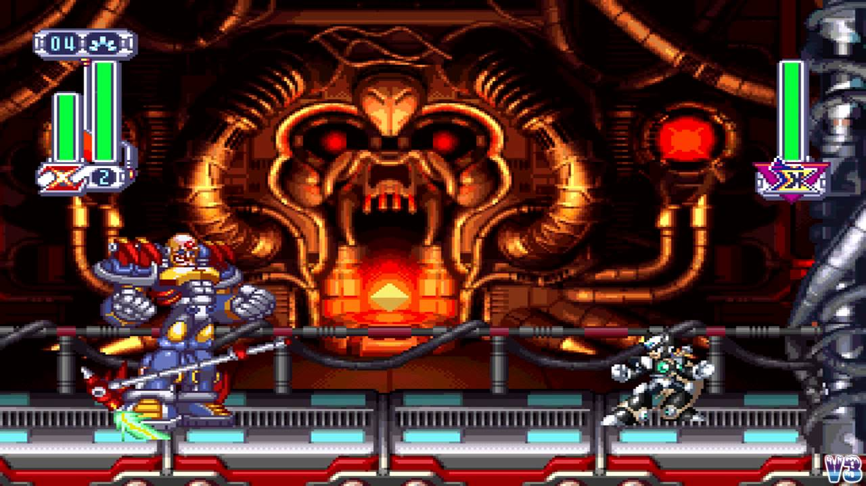

Slide 15
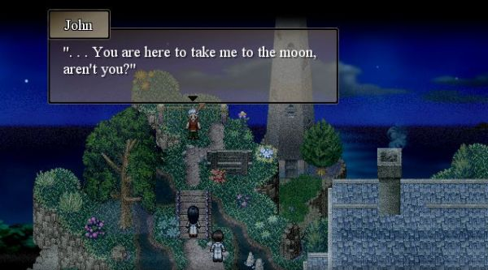

Slide 16
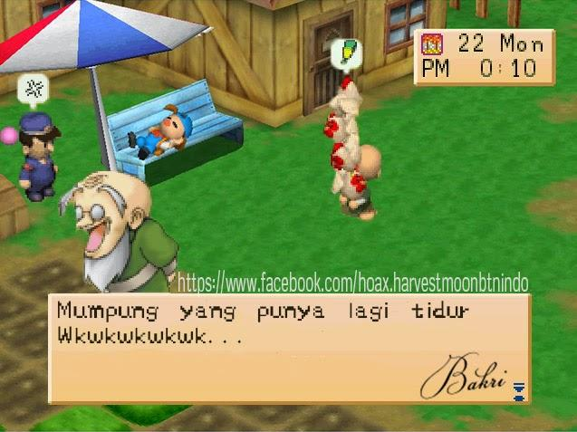

Slide 17
2. Game Element Exploration
a. Narrative formation
b. Game design
c. Objectives
d. Player options
e. Sequences
f. Mechanics
g. Game aesthetics
h. Dramatic elements
i. Multimedia inclusions

Slide 18

3. Game Play
a. Game theory introduction
b. Balance
c. Challenge development
d. Level design
https://www.youtube.com/watch?v=3Y1WpytiHKE
Notes:
a. Prisoners Dilemma

Slide 19
4. Game Analysis
a. Game play critical analysis
b. Functionality
c. Aesthetics
d. Game play

Slide 20

5. Project Management for Game Development
a. What is Project Management?
b. Why is Project Management important?
c. The Four Phases of Project Management (model)
Notes:
Project manajemen

Slide 21
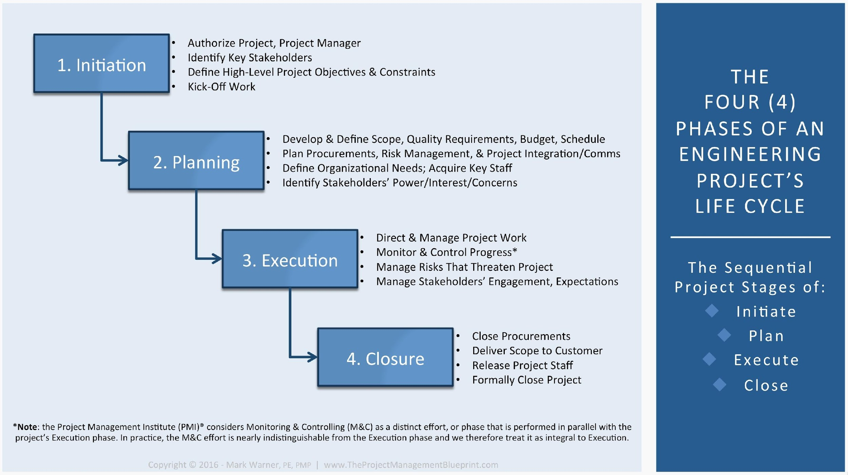

Slide 22

6. Unity Editor for Game Creation
Setting up a new project
Navigating within the Unity Editor

Slide 23
SPL Activities

Slide 24
Exploring the Unity Editor
1. Learning the Interface Tutorial:
http://docs.unity3d.com/Manual/LearningtheInterface.html
2. Editor Basics:
http://unity3d.com/learn/tutorials/modules/beginner/live-training-archive/editor-basics

Slide 25
Game Developers Journal Entry
Within your Game Developers Journal, enter at least five core game (i.e. product) ideas to be considered for your final Capstone Project. These do not need to be very detailed ideas, just a few sentences to capture the main game concept. Later, one of these ideas will be developed and delivered as your final Capstone Project submission.

Slide 26
Contemporary Game Assignment -1
Download Candy Crush Saga onto any gameplay device. The game can be found at:
http://candycrushplayfreegame.com.
Play the game long enough to understand the directions and the overall objective(s) of the game.

Slide 27
Contemporary Game Assignment -2
Produce a Game Modification Task Sheet document by identifying the following:
• What platform is used to play the game?
• What is the objective of the game?
• What three things do you like about the game?
• What three things did you not like about the game?
• List three reasons why you think this game is popular and successful.

Slide 28
Contemporary Game Assignment -3
Based on your own observations, create a written plan for modifying the
game. This document will serve as your Game Modification Plan.
Your plan should include the following:
• Re-write the main goal of the game.
• Describe how you would improve the game. Be as specific as possible!
• List three reasons why your ideas may not have been implemented by the original designers.
• List three reasons why you think players would like your changes.
• List three reasons why these changes would be difficult to implement.

Slide 29
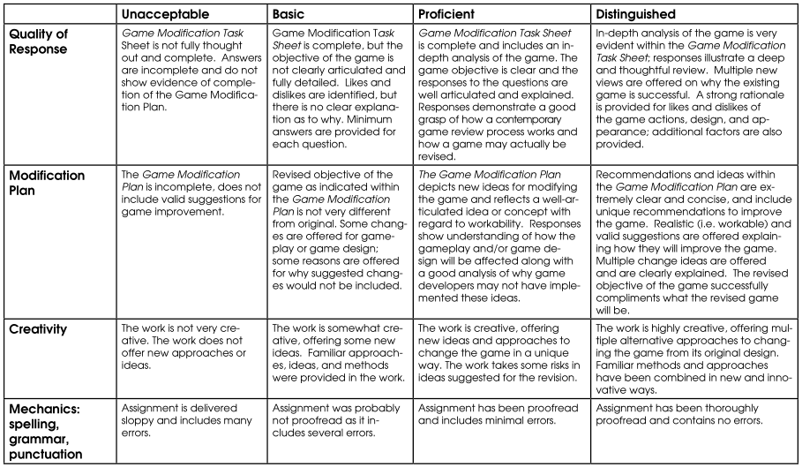
ASSESSMENT REFERENCE GUIDE

